Slide 1
Public Portal Training
Presented By:
Lucía Lapaz, Brittany Ersery & Jim Holsinger
Envision Technology Partners, Inc.
September 2019

Slide 2
Agenda
Obtain Personal Immunization Record (minor)
Obtain Personal Immunization Record (adult)

Slide 3
Public Portal

Slide 4
Overview
Patient Record verification (under 18 years)
Patient contact
Patient
Parent
Guardian
Phone number/Email
Will be verified by phone numbers and email addresses stored in the patient’s Contacts.

Slide 5
Overview (cont.)
Patient Record verification (over 18 years)
Only the Patient can view their record
Phone number/Email
Will be verified by phone numbers and email addresses stored in the patient’s contact information.

Slide 6
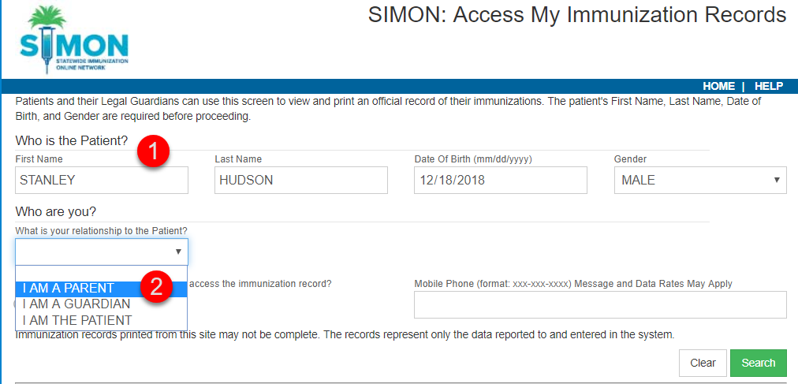
Request Record
Enter Patient Information
Select relationship to patient

Slide 7
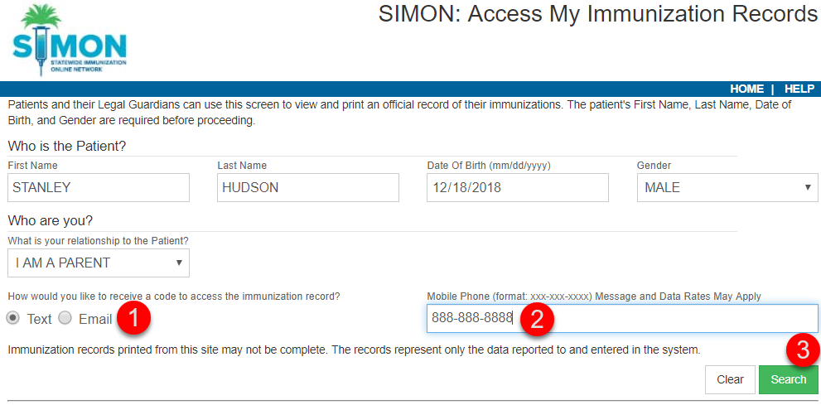
Request Record (cont.)
Select Text/Email for the access code
Enter in mobile phone or email
Click Search

Slide 8
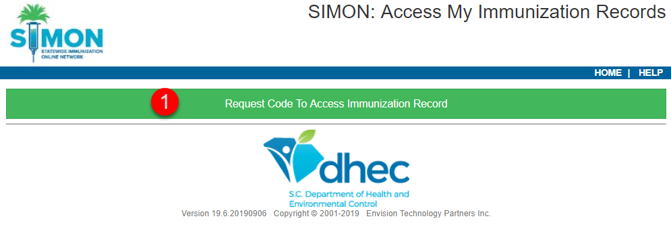
Access Code
Click to have access code sent to phone or email.
Enter in access code
Click verify to view record

Slide 9
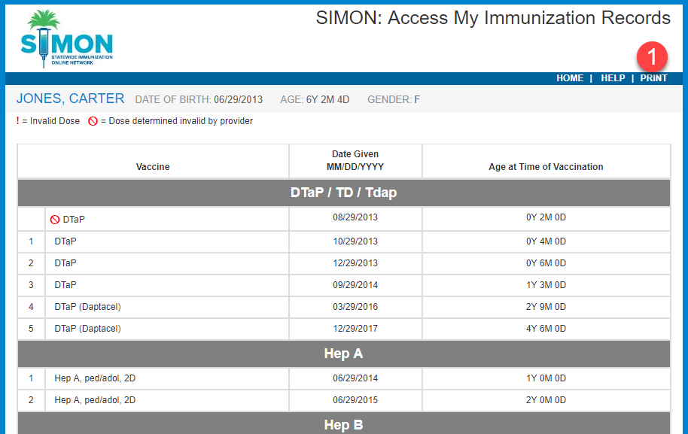
Personal Immunization Record
Click PRINT to generate Personal Immunization Record PDF.

Slide 10
Public Portal
Hands-On Exercise

